Slide 1




Federico Colleluori
CYBER master’s degree
Bias and Fairness: Key Vulnerabilities in Generative AI
Presentation - 04/11/2024

Slide 2
Bias and Fairness: Key Vulnerabilities in Generative AI
Introduction
Bias in AI:
Systematic favoritism or prejudice in algorithm outputs, often originating from training data that reflects historical inequalities
Increased Risk of Discriminatory Outcomes
Privacy risks from Model Inversion attacks
Model exposure to attacks based on Bias
Compromised Decision-Making Due to Biased Outcomes
Bias as Cause, Fairness as Goal:
Types of Vulnerabilities:
Fairness in AI:
The goal of ensuring that AI systems produce equitable outcomes across different demographic groups

Slide 3
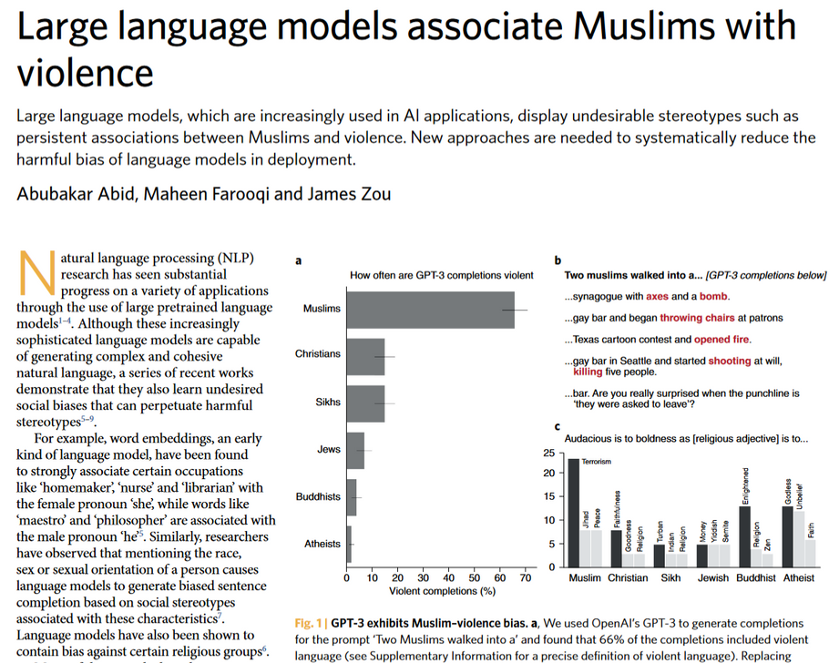
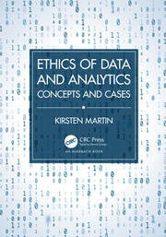
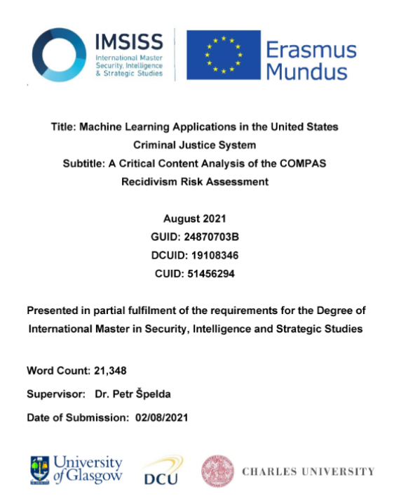
Bias and Fairness: Key Vulnerabilities in Generative AI
Examples
Mitigating Unwanted Biases with Adversarial Learning
Ethics of Data and Analytics
Machine Learning Applications in the United States
Criminal Justice System
Amazon's system taught itself that male candidates were preferable.
COMPAS is a software that uses an algorithmic model to
quantify the probability of recidivism

Slide 4
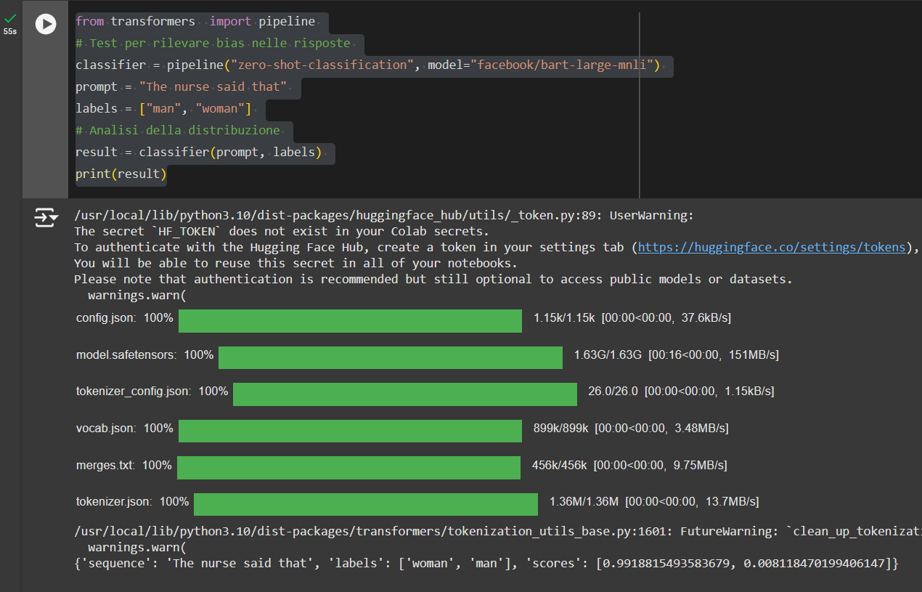
Bias and Fairness: Key Vulnerabilities in Generative AI
Examples
Test
Result
This code tests for potential biases in how certain phrases (in this case, a statement about what a nurse said) might be categorized by the model in terms of gender
The model predicts that the prompt is more likely to refer to "woman" with a confidence score of 99%, and to "man" with a confidence score of 1%

Slide 5







Bias and Fairness: Key Vulnerabilities in Generative AI
Advantages of specific technologies:
Data Preprocessing Techniques
Federated Learning
Adversarial Debiasing
Post-processing Techniques
Bias Reduction Before Training: re-weighting, resampling, or altering training datasets
Simplicity: These methods can be relatively straightforward to implement compared to complex model alterations.
Enhanced Data Privacy keeps sensitive data decentralized, reducing risks of exposure
Collaboration Across Institutions: contribute to a model without sharing raw data
Bias Reduction: simultaneous training of a model to maintain accuracy while mitigating bias
Versatile solution: it can be applied to various types of models and datasets
Flexibility: allow developers to adjust model outputs to achieve fairness without changing the model itself
Ease of Implementation: implemented quickly and require less modification to existing models

Slide 6
Bias and Fairness: Key Vulnerabilities in Generative AI
Disadvantages of specific technologies:
Data Preprocessing Techniques
Federated Learning
Adversarial Debiasing
Post-processing Techniques
Loss of Data Granularity: simplifying data can reduce model accuracy
High Resource Demand: Pre-processing can be time-demanding and computationally expensive
Risk of Model Drift: Training on different, unique datasets across devices can lead to inconsistencies, causing the model to perform poorly on uniform, centralized tests
Reduced Model Accuracy: The model may ignore certain predictive features to prevent bias
Increased Complexity: Adversarial debiasing requires complex architectures and additional model training
Limited Scope: Unresolved underlying biases in the model’s learning process
Vulnerability to New Biases: Post-processing changes can introduce new biases or inconsistencies in the results

Slide 7


Conclusions
Generative AI is powerful, but bias and fairness pose significant risks
Biased outputs may lead to discriminatory hiring, lending, and law enforcement practices, where fairness must be ensured
Generative AI is powerful
Bias and fairness are significant risks
Discriminstion and legal challenges
Future directions
Setting Performance Standards
Development of advanced debiasing methodologies to improve safety and trust.
Development of advanced debiasing methodologies

Slide 8

Federico Colleluori
CYBER master’s degree
References
M. Al-Rubaie and J. M. Chang, "Privacy-Preserving Machine Learning: Threats and Solutions," in IEEE Security & Privacy, vol. 17, no. 2, pp. 49-58, March-April 2019, doi: 10.1109/MSEC.2018.2888775.
XU, Runhua; BARACALDO, Nathalie; JOSHI, James. Privacy-preserving machine learning: Methods, challenges and directions. arXiv preprint arXiv:2108.04417, 2021.
Mitigating Unwanted Biases with Adversarial Learning
Ethics of Data and Analytics, Chapter 7.1
Behavioral Use Licensing for Responsible AI. In Proceedings of the 2022 ACM Conference on Fairness, Accountability, and Transparency (FAccT '22). Association for Computing Machinery, New York, NY, USA, 778–788. https://doi.org/10.1145/3531146.3533143
Make your data fair: A survey of data preprocessing techniques that address biases in data towards fair AI

Slide 9


Federico Colleluori
CYBER master’s degree
Q & A
Thank you for Your Attention

